Slide 1
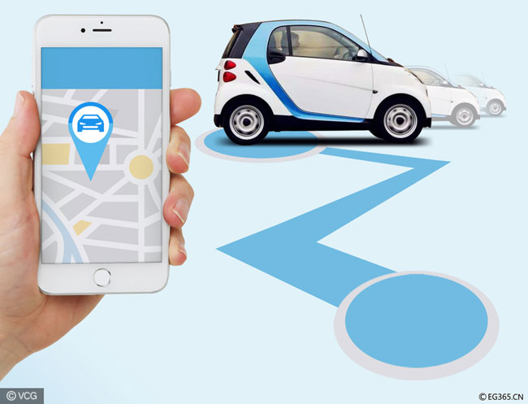
Achieving Sustainable Transportation by Car Sharing
IEDE THU 2018
2017200604 Francesco Maria Augusto Ghidoni
2016280082 Pralhad Gupta
2017280030 Kristina Miladinoska
2017280364 Benny Wijaya
S20161476 Mohammad Shohiduzaman

Slide 2
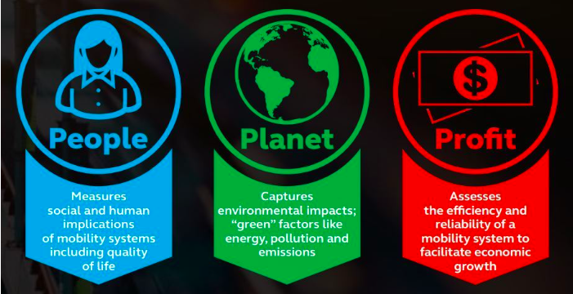
What is Sustainable Mobility?

Slide 3


Where?
BEIJING

Slide 4

WHY EV CAR-SHARING in BEIJING
→Air pollution;
→Congestion
→high cost of car ownership
→$15,000 for a license plate: only 1 on 20 can have it
→ High cost of parking space and insurance.

Slide 5
WHY INVEST IN EV?
Reduce consumption of oil-based fuels and boost China’s energy independence
Reduce carbon dioxide emissions and air pollution.
Chinese industry can become a global leader.

Slide 6

AIR POLLUTION in BEIJING
In 2013, Beijing registered what the New York Times labelled as “Crazy Bad” AQI of 755

Slide 7

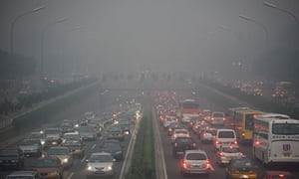
PROBLEM of TRAFFIC JAM

Slide 8
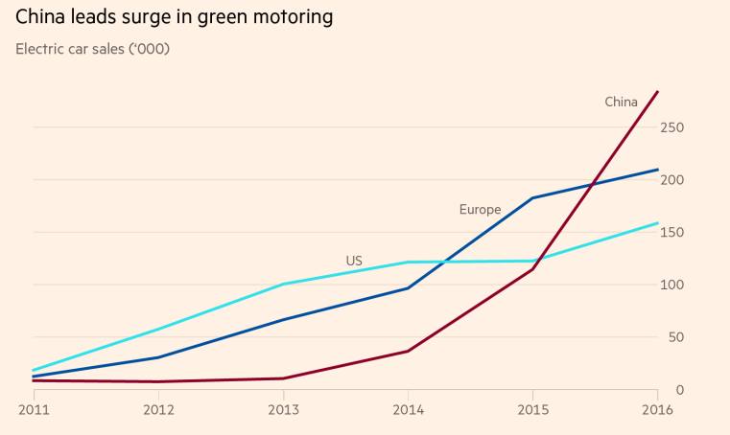
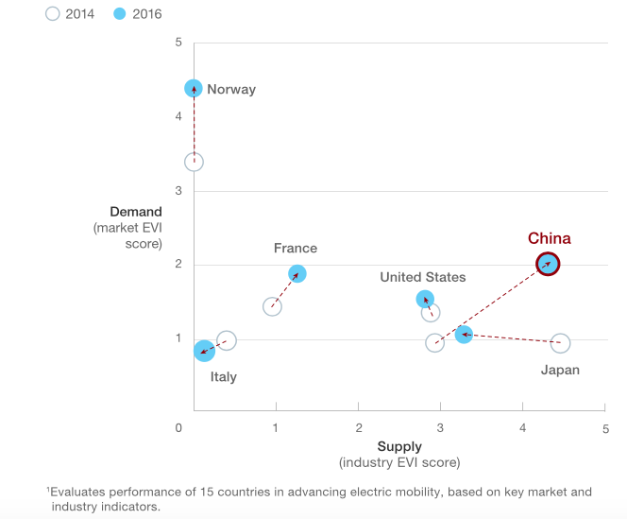
EV in CHINA
43% of EV production worldwide: world’s largest maker of electric vehicles.
Electric vehicles (EVs): part of Made in China 2025 strategy.
Beijing expects spending to top 400bn RMB between 2015 and 2020 in Subsidies

Slide 9
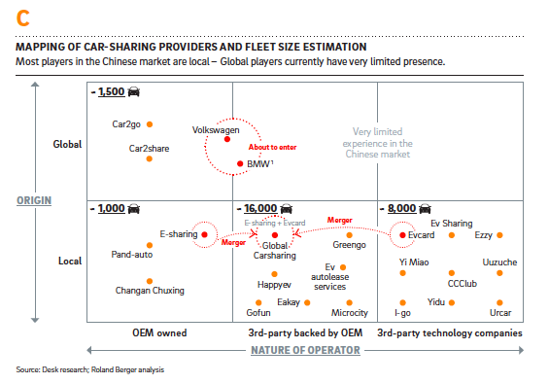
CAR-SHARING in BEIJING
Current customers: 25 - 35 years
70 % of surveyed young adults in Beijing and Shanghai are interested in the car-sharing Service.
→Awareness of the concept of sharing
→Limited nature of private vehicle ownership.
→Frequent mobility needs.

Slide 10
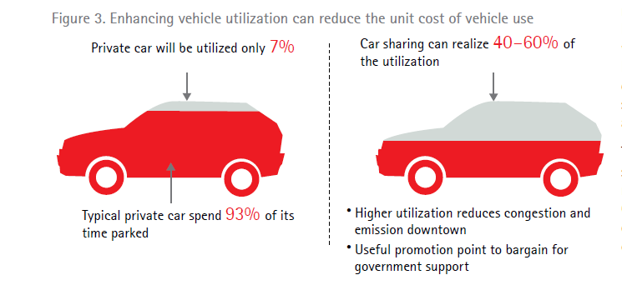

Slide 11
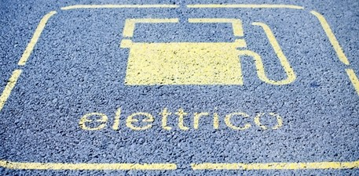
Areas of Concern
Technical Constrains & Barriers
Technology Innovation and extensive R&D
Government’s regulations & Policies
Governing laws, regulations, requirements, incentives, etc.
Socio-economic
Environmental constraints
“Save Earth”
AI
Economic feasibility
“of the people, for the people, and by the people”- Idea of Democracy in Technology.
Global Issue
International Pressures

Slide 12

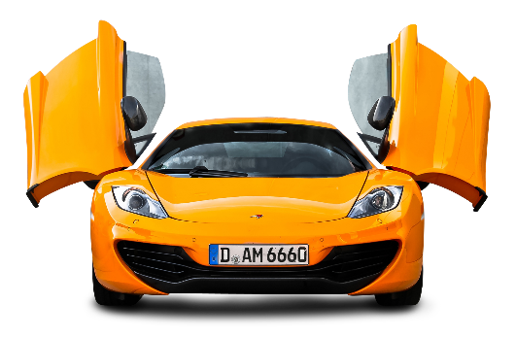
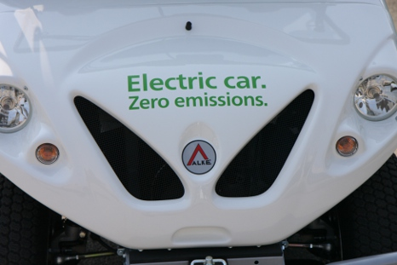
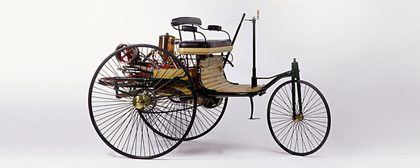



Transportation: Past, Present & Future
Powerful
Efficient
Better fuel economy
Cheap/Cost-Effective
Intelligent
Comfortability, reliability, durability
Excellent Quality
Safe/Crash-worthiness
“For thousand of years, the tide of transportation rose and fell with the rise and fall of the population”.(George Gooch)
Benz Patent Motor Car:
The first automobile (1885–1886)
one-cylinder two-stroke unit (engine output was 0.75 hp (0.55 kW)
Koenigsegg Regera
Over 1500 hp or 1.11 MW
Total Propulsion-ICE+ED

Slide 13
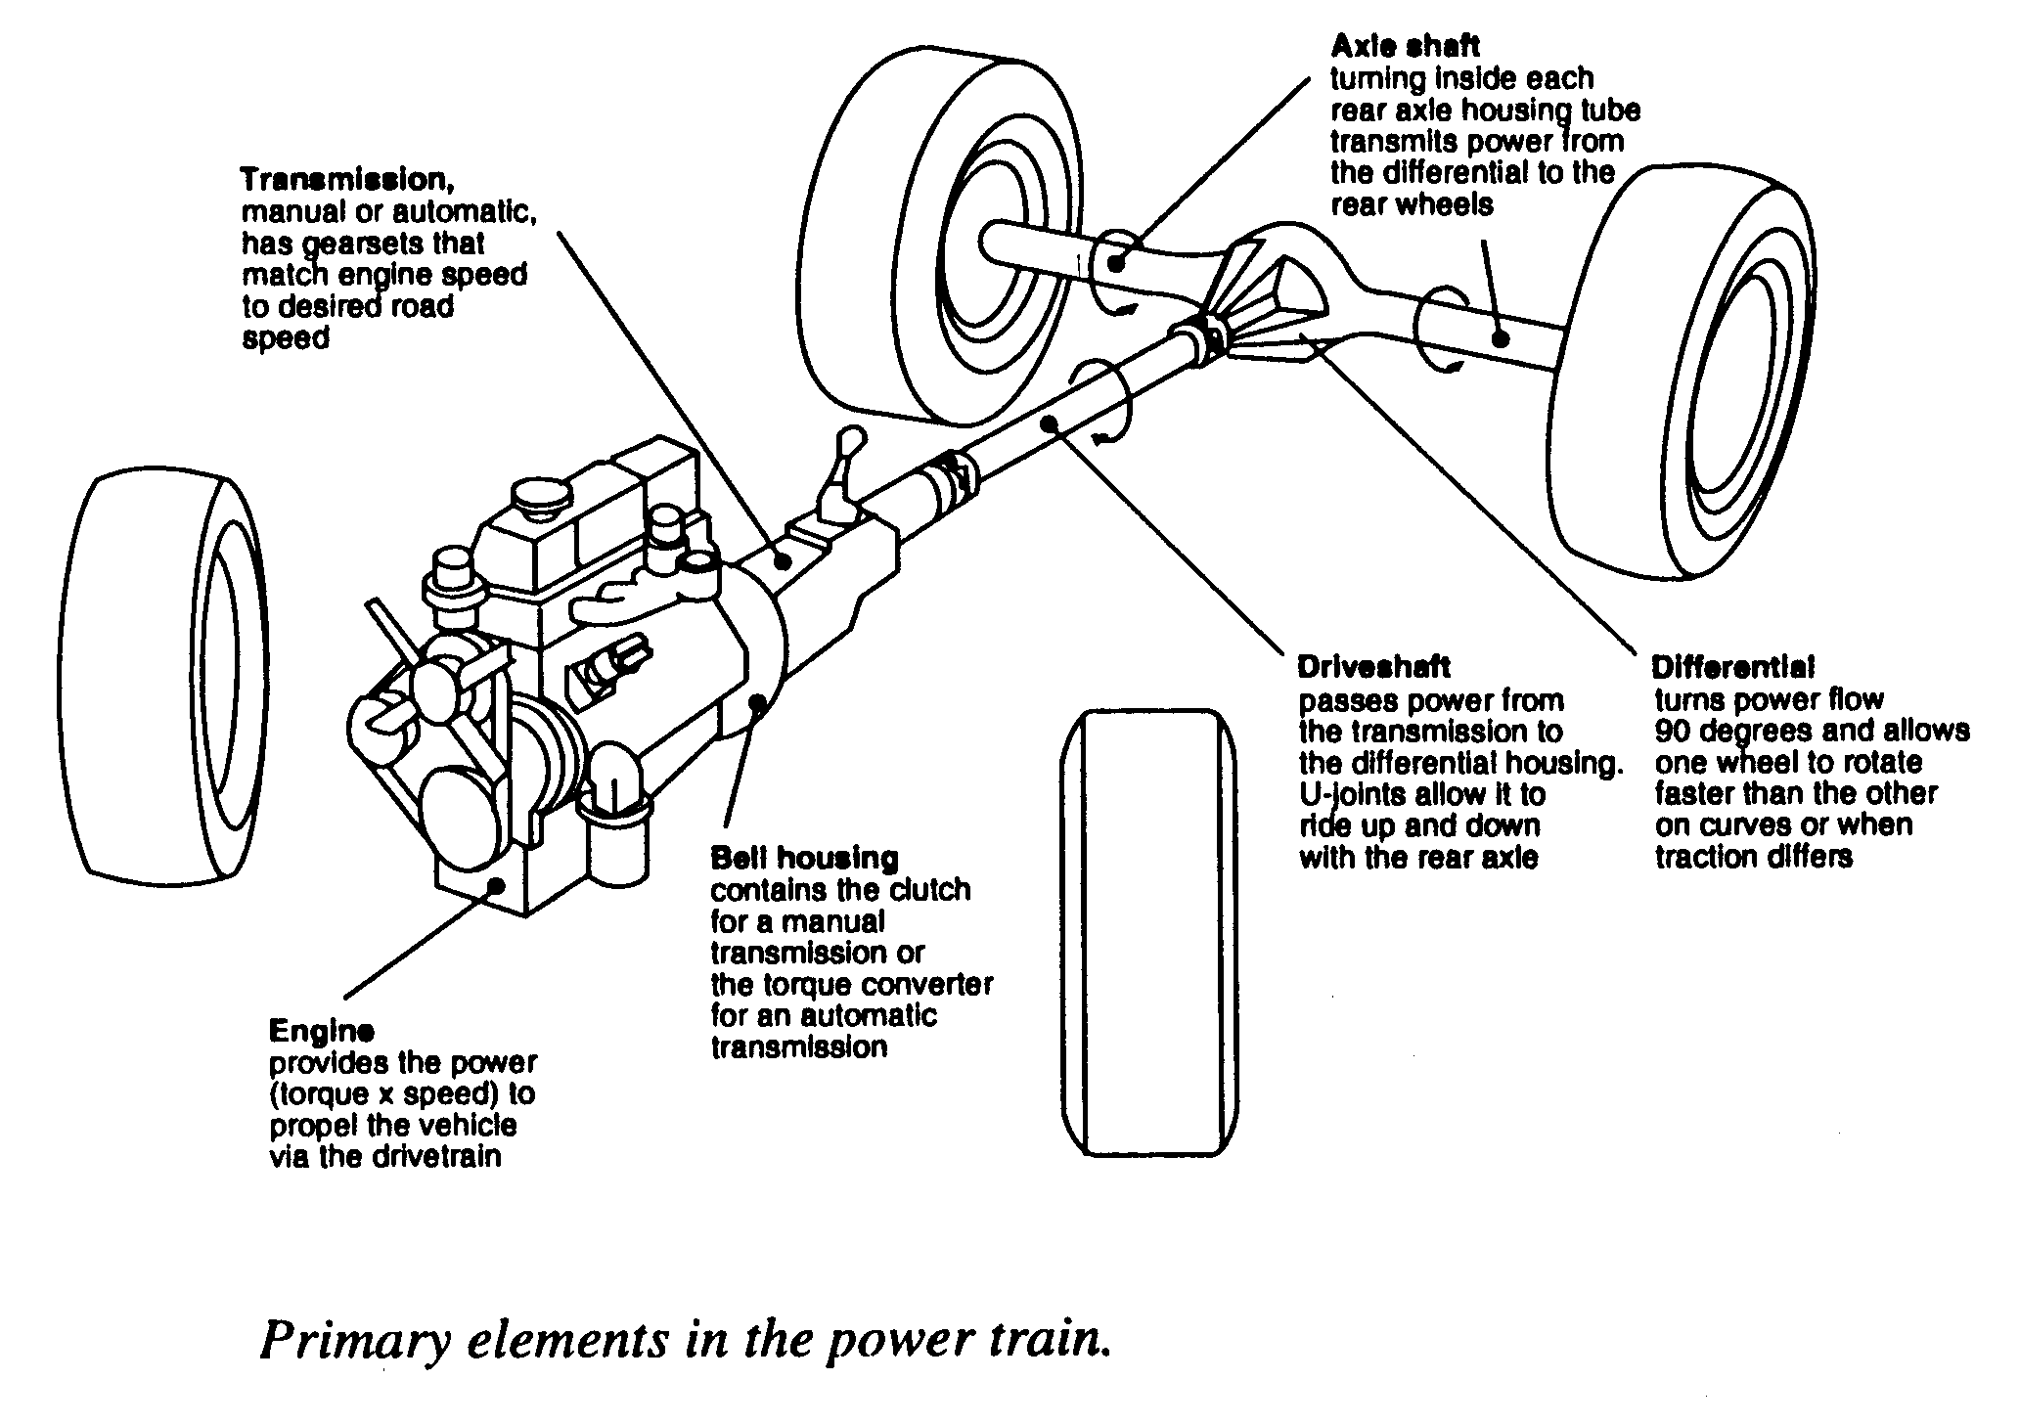

How many propulsion or fuel options are available in the world?
The term propulsion is derived from two Latin words: pro meaning before or forwards and pellere meaning to drive.
Propulsion System (Engine)

Slide 14
Propulsion Options
Gasoline Engines
Spark Ignition Internal Combustion Process
Port Fuel Injection
Diesel Engines
Fuel Injection
Mixture Formation
HCCI Variation/Evolution
HCCI, RCCI, PPCI, MPCI
Special Combustion Processes
HCCI
Gasoline Direct Injection
Diesel Combustion
Advanced Powertrains
FCV
BEV
HEV

Slide 15
Technologies developed
New Generation of Batteries
Inductive Charging
Battery Swapping
Solar Panel

Slide 16
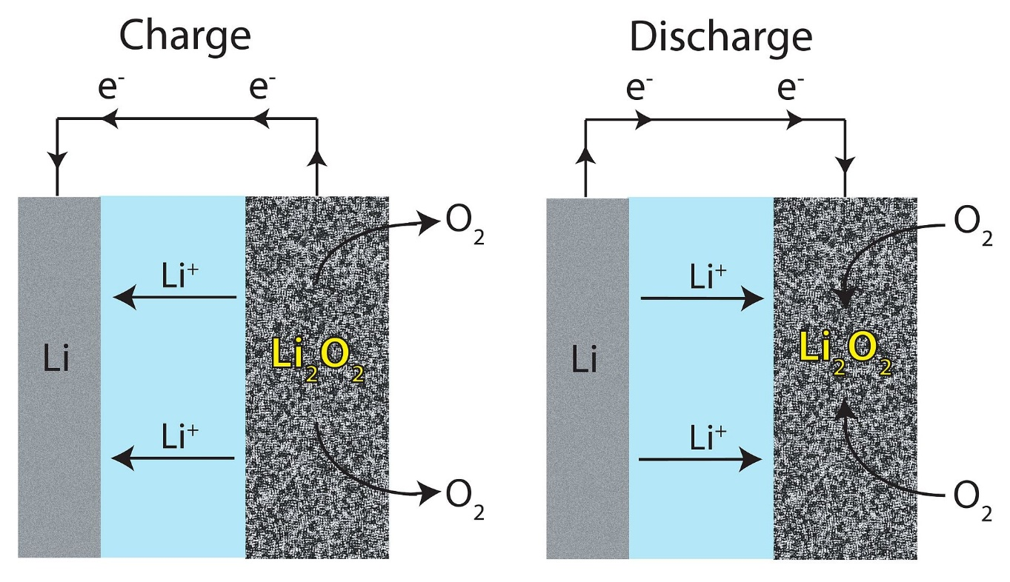
New generations of batteries
Lithium-air battery : - highest theoretical specific energy→12 kWh/kg (13 for gasoline)
gasoline→ wheels : 1,7 kWh/kg vs electric motor (η=95%)

Slide 17
Issues?
The need for high voltages for charging
a low efficiency <1 kWh/kg
low cycle lifetimes
Parasitic reactions : LiOH

Slide 18
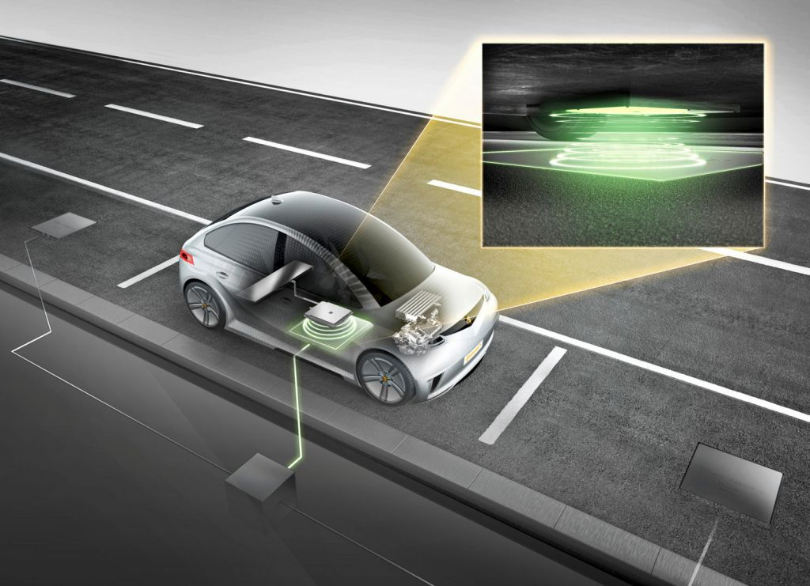
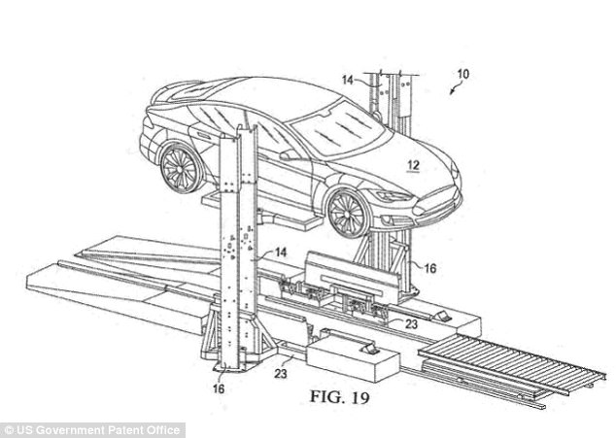
Other technologies
Inductive Charging
Battery Swapping
Solar Panel

Slide 19
Infrastructures
Charging Stations
Inductive Charging
Battery Swapping
Vehicle-to-Grid (V2G)

Slide 20
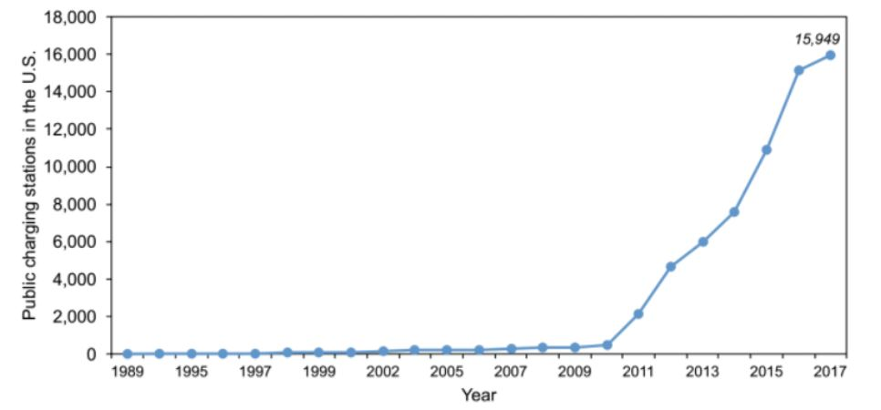
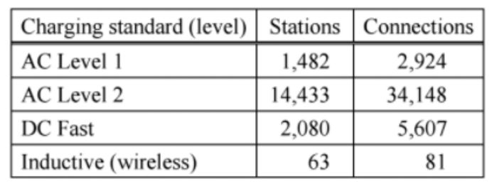
Charging stations

Slide 21
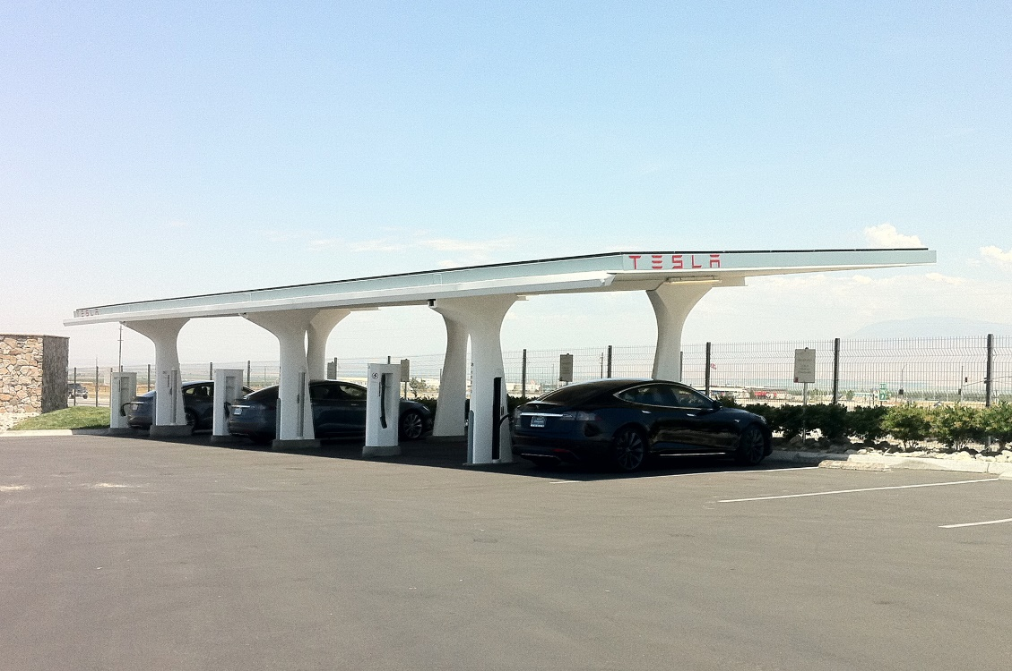
Charging Stations
Continuos Increasing
Several Actors (Tesla, the US Government)
→ Even Volkswagen with $2 bn! (open charger)

Slide 22
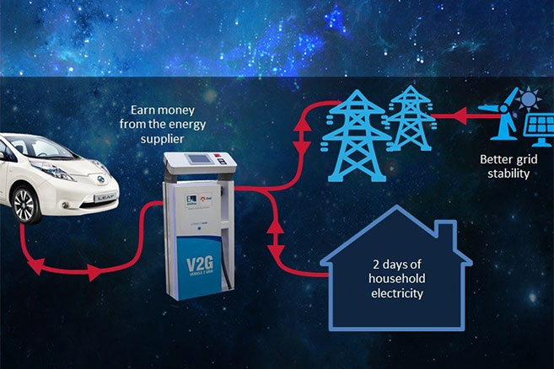
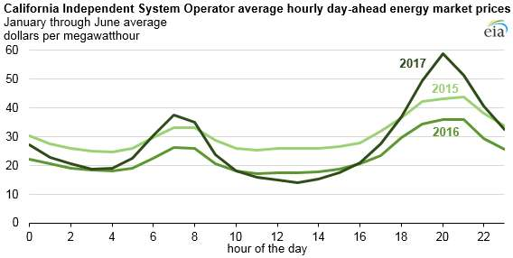
Vehicle to Grid

Slide 23
Points to end
Technologies are being actively developped
Charging stations are prioritized.
Smart grid will be a key element.

Slide 24
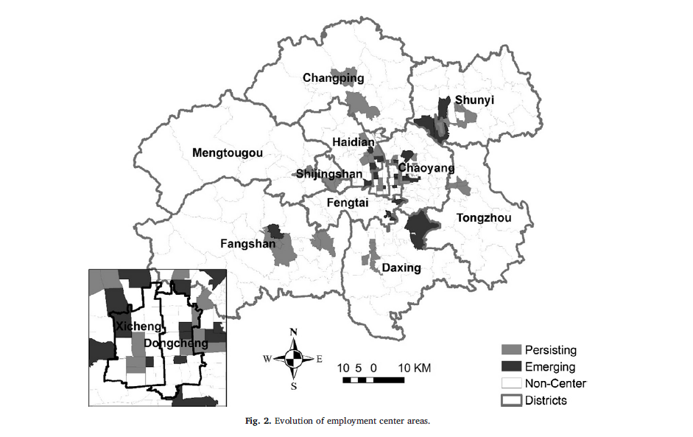
Pilot in collaboration with emerging business centers, A-B sharing model, expand to 2nd their cities in second phase

Slide 25
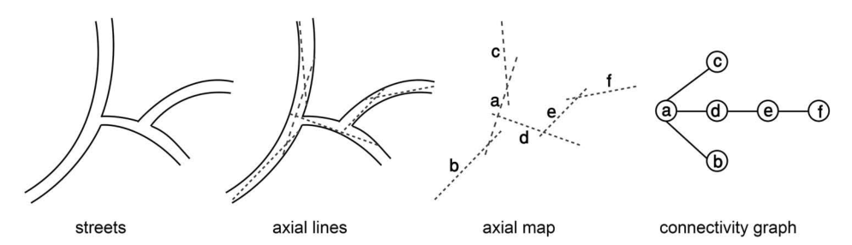
Methodology
Street network simplification
The potential location of charging space
which emphasizes the topological distance in street network
Evaluation indices：
Through-movement (Betweenness)
Notes:
Situate the charging space

Slide 26
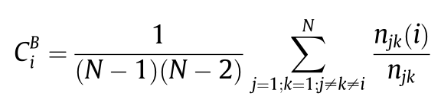
Methodology
through-movement point (Betweenness)
C_{C}
C_{B}
B
Betweenness centrality C_{B} measures how often a node is traversed by the shortest paths connecting all pairs of nodes in the network. C_{B} is defined as:
where n_{jk} is the number of shortest paths between nodes j and k, and n_{jk} (i) is the number of these shortest paths that contain node i. C_{B} captures a special property for a place: it does not act as an origin or a destination for trips, but as a pass-through point. C_{B} represents a node’s volume of through traffic.
Notes:
These attributes represent the potential through-movement (Betweenness) and to-movement (Closeness) of any given axial line

Slide 27
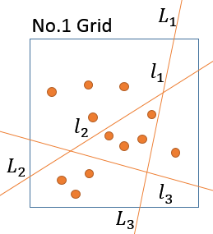
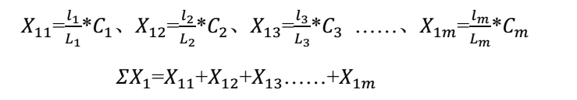
Methodology
Setting a fishnet in urban space and divide it into same-sized grids.
Transferring line centrality to space centrality
Making location more precise
Taking Euclidean distance in to account
Notes:
Situate the charging space

Slide 28

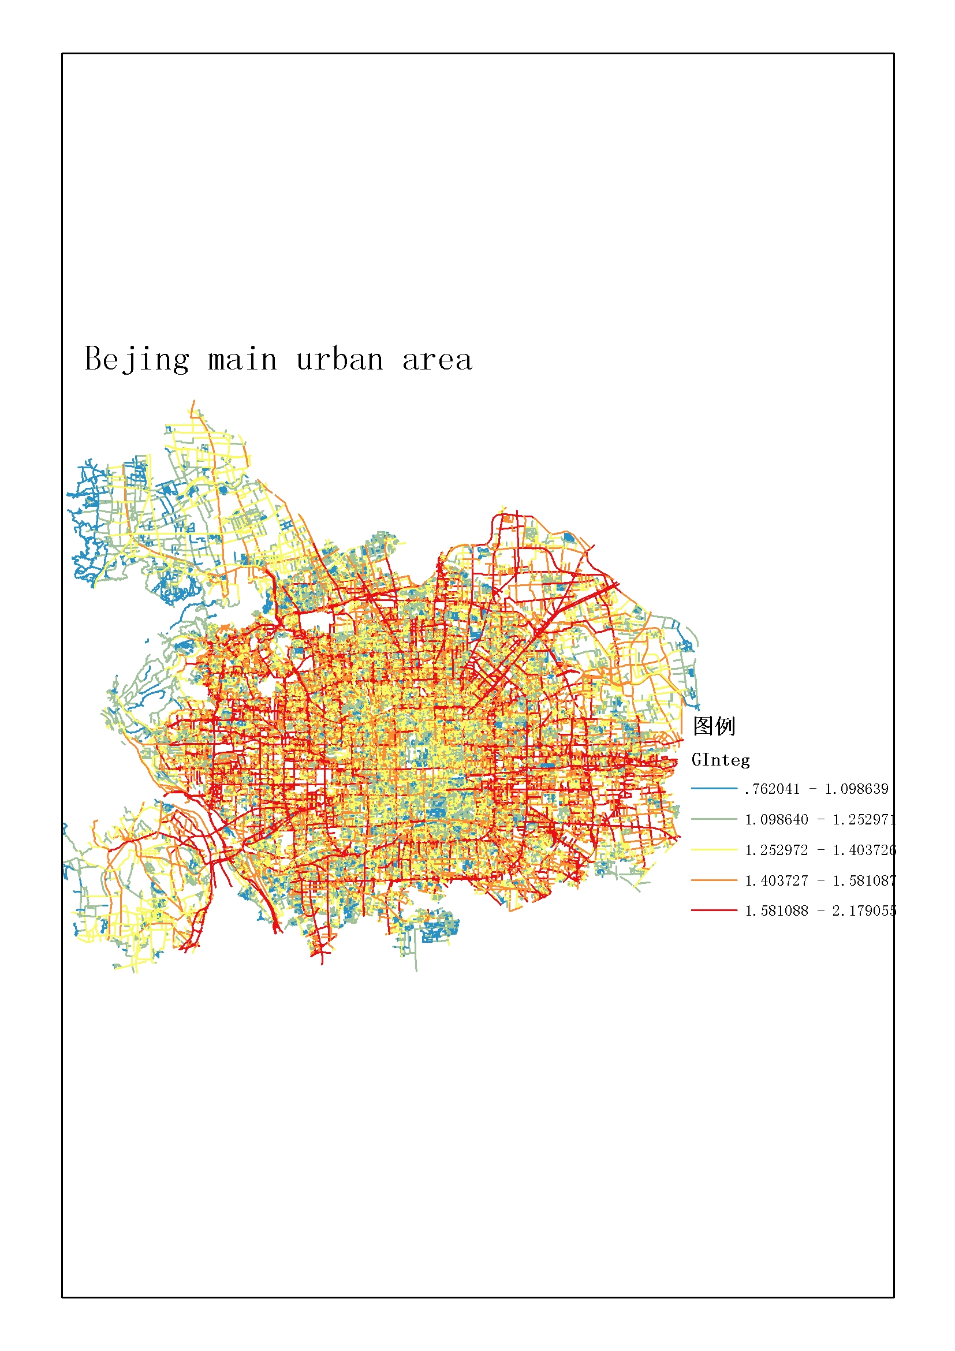
Study area:
Charging Station Location :
Calculation result
Notes:
These attributes represent the potential through-movement (Betweenness) and to-movement (Closeness) of any given axial line

Slide 29

Study area:
Charging Station Location :
Notes:
These attributes represent the potential through-movement (Betweenness) and to-movement (Closeness) of any given axial line

Slide 30





Demand point location :
Charging Station Location :
10 demand point
20 demand point
50 demand point
30 demand point
40 demand point

Slide 31

EV CAR SHARING PROMOTION
Government can began to offer incentives and programs aimed at increasing the sale of EV and the enhancing of EV car sharing.

Slide 32

MARKETING PLAN

Slide 33
LONG TERM PROMOTION PLAN
“Low and zero-emissions vehicles should always be more economically beneficial to residents, than diesel powered ones…”
Promote Beijing EV HUB
Strong urban policy
Establishment fast Charging Station in Beijing roads by 2030
Promote EV Production to Local EV Company
Support R&D
Promote for local users and makers

Slide 34


Market research
PRICE
UNIQUE SERVICES
COMPETITIVE ADVANTAGE

Slide 35



Program packages

Slide 36
Key partners 1. Local Government 2. EV manufacturer 3. Real-estate Developer 4. Insurance company 5. Parking lot operators 6. Shared-office spaces | Key Activities 1.Develop and maintain app 2. Fleet acquisition 3. Track and act on costumer feedback 4. Engage with partners to develop a network of parking lots | Value Proposition 1. Flexible mobility without the hassle and expense of owning a car 2. High quality and environmentally friendly commute |  | Customer relationships 1. automated, the customer relies on self-service through a tailored mobile or website based interface | Customer segment 1. Start-ups at shared office spaces 2. Commuters working at emerging business centers (predictable routes) 3. Young Adults 4. Tourists residing at specific hotels (incentives for predictable routes)
 | Key Resources 1. Car Fleet 2. Parking lot agreements 3. Workforce 4. Software licensing |  |  | Channels 1. Mobile app 2. Website 3. Fleet
Cost structure 1. Vehicles depreciation 2. Parking and dispatch costs 3. Salaries 4. Software 5. Marketing |  |  | Revenue stream Annual or Quarterly Subscription Rental Fee by the km (1 to 1.5 RMB per km) Advertising

Slide 37
References
Clover, C. (2017, October 12). Electric cars: China’s highly charged power play. Financial Times.
Hertzke, P., Müller, N., & Schenk, S. (2017, July). Dynamics in the global electric-vehicle market. McKinsey & Company.
Clover, C. (2017, October 24). Subsidies help China sell the most electric cars. Financial Times.
Gao, P., Malorny, C., Sha, S., & Guan, M. (2015). Supercharging the Development of Electric Vehicles in China (Rep.). McKinsey & Company.
Krieger, A., Radtke, P., & Wang, L. (2012, July). Recharging China’s electric-vehicle aspirations. McKinsey & Company.
R. Z., Dr. (2017). Car-Sharing in China: How to operate a successful business (pp. 1-16, Tech.). Munich, Germany: Roland Berger.
Committee (R&D) Electric Vehicle Association of Thailand (2017),Business Trend: Opportunities and Challenges and Way Forward for “Go Green” in EV Business in Thailand
How to promote EV Car; https://cleantechnica.com/2016/01/28/how-to-best-promote-electric-cars/
chinadaily.com.cn; Car-sharing market floundering in China; http://www.chinadaily.com.cn/business/motoring/2017-03/20/content_28609872.htm
Joshua Pundra(2018) How to promote car-sharing to people who love their own cars; https://discovery.rsm.nl/articles/detail/331-how-to-promote-car-sharing-to-people-who-love-their-own-cars/

